Slide 1
CMR INSTITUTE OF TECHNOLOGY
AUTOMATING E-GOVERNMENT SERVICES WITH ARTIFICIAL INTELLIGENCE
M.Akkashh 16R01A05M8
B.Sreeshma 16R01A05N9
G.Sahithi 16R01A05L2
V.Mrunalini 16R01A05P7
Under the Guidance of Dr.S.Alagumuthukrishnan

Slide 2
CONTENTS
INTRODUCTION
ABSTRACT
EXISTING SYSTEM
PROPOSED SYSTEM
MODULES
ARCHITECTURE
ALGORITHM
CONCLUSION
REFERENCES

Slide 3
INTRODUCTION
In this project we have described concept of Automated Opinion Detection for government Services with Artificial Intelligence technology such as Deep Learning Algorithm called Convolution Neural Networks (CNN).
Artificial Intelligence (AI) has recently advanced the state-of-art results in an ever-growing number of domains. AI can be defined as the ability of a computer to imitate the intelligence of human behaviour while improving its own performance
Objective : Address the challenges of automate and detect people’s opinion on e-government services

Slide 4
ABSTRACT
We have developed a concept to implement multiple CNN models in which one model can detect or recognize people’s hand written digits
Second model can detect sentiment from text sentence which can be given by people’s about government services.
Third model can detect sentiment from person face image.

Slide 5
EXISTING SYSTEM
In the Existing system we get reviews from people for facilitating e-government services in the following
Manual opinion
Oral opinion
Online opinion
But at present we are not using AI technologies to automate and detect the review of the people.
We don’t have facial recognition based opinion in the current scenario
We also don’t have sentiment based recognition using text review in the current system

Slide 6
PROPOSED SYSTEM
We are proposing a framework which contains multiple CNN models, using which we can do the following things to automate from public review for facilitating e-government services and schemes
Recognize Human Hand written digits
Sentiment from text sentences
Detect sentiment for person face

Slide 7
MODULES
Generate Hand Written Digits Recognition using Deep Learning CNN Model
Upload Test Image & Recognize Digit
Generate Text Based Sentiment Detection using Deep Learning CNN Model
Text Your Opinion About Government Services
Display People’s Sentiments From Text Reviews
Upload captured Face Expression Photo of people’s opinion about Government Services
Detect Sentiments from Face Expression Photos

Slide 8
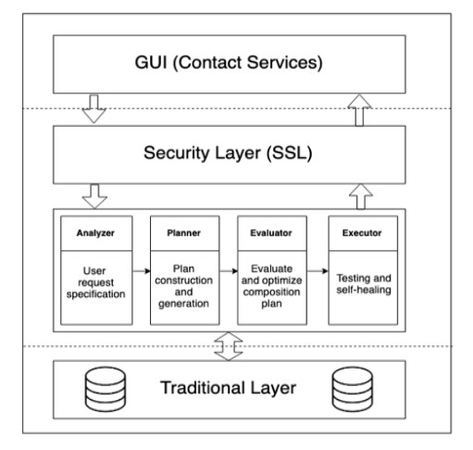
ARCHITECTURE
Architecture overview for
a smart e-government services platform.

Slide 9
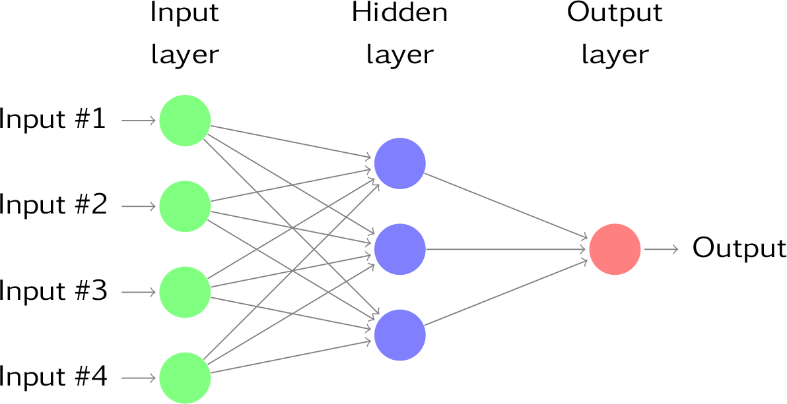
ALGORITHM
Convolution Neural Network (CNN)
In deep learning, a convolutional neural network (CNN, or ConvNet) is a class of deep neural networks, most commonly applied to analyzing visual imagery

Slide 10
REFERENCES
K. He, X. Zhang, S. Ren, and J. Sun, ‘‘Deep residual learning for image recognition,’’ in Proc. IEEE Conf. Comput. Vis. Pattern Recognit., Jun. 2016, pp. 770–778.
Y.-D. Zhang, Y. Zhang, X.-X. Hou, H. Chen, and S.-H. Wang, ‘‘Sevenlayer deep neural network based on sparse autoencoder for voxelwise detection of cerebral microbleed,’’ Multimedia Tools Appl., vol. 77, no. 9, pp. 10521–10538, May 2018.
S. Venugopalan, H. Xu, J. Donahue, M. Rohrbach, R. Mooney, and K. Saenko, ‘‘Translating videos to natural language using deep recurrent neural networks,’’ 2014, arXiv:1412.4729.
D. Silver, A. Huang, C. J. Maddison, A. Guez, L. Sifre, G. van den Driessche, J. Schrittwieser, I. Antonoglou, V. Panneershelvam, M. Lanctot, S. Dieleman, D. Grewe, J. Nham, N. Kalchbrenner, I. Sutskever, T. Lillicrap, M. Leach, K. Kavukcuoglu, T. Graepel, and D. Hassabis, ‘‘Mastering the game of Go with deep neural networks and tree search,’’
C. Bishop, Pattern Recognition and Machine Learning. New York, NY, USA: Springer, 2006.

Slide 11
THANK YOU

